Slide 1
Social & Welfare Officer Training
Jo Mannion & Lisa McCormick
Club Development Officer & Club Development Administrator

Slide 2
Welcome!
Students Union
Roles of a Social Welfare Officer
Initiations
Socials
Tour
Social Media
Welfare
Inclusion
Disciplinary

Slide 3
Leeds Beckett Students Union
Jason Shield
Venue Manager

Slide 4
Role of the Social & Welfare Officer
Notes:
This is not a suggestion that everything bad that happens in your club is your fault. We want to provide you with the tools and information to be able to do your job.

Slide 5
Initiations

Slide 6
Small Groups
5 mins
What is an initiation
What types of initiations have you heard about?
What are you experiences of initiations
Did you have to do an initiation?
Any stories to share?
Be prepared to feedback

Slide 7
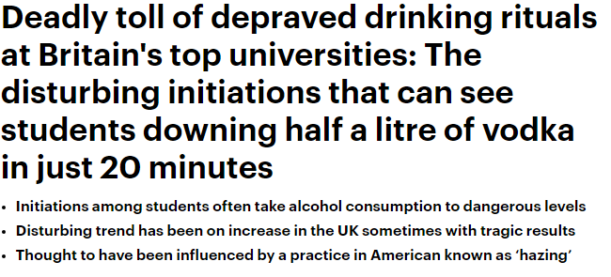
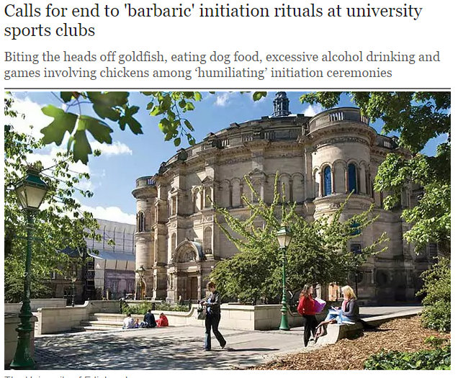
What is an initiation and why are they banned?
DEFINITION: ‘the action of admitting someone into a secret or obscure society or group, typically with a ritual’
Notes:
Banned
Important for student retention
Actually stops students from engaging with the sports teams

Slide 8
CASE STUDY:
https://www.youtube.com/watch?v=S7Tdj4ymdA8
Carson Stark was an 18 year old pledging to a Fraternity at Cal Poly, California.
Pledge Initiation night given
750ml rum
1 or 2 bottles of Everclear – 95% proof

Slide 9
Socials

Slide 10
Socials
Part & parcel of being in a sports team
Good for boosting team morale
Can help grow your membership
Good for new members to feel part of the team

Slide 11
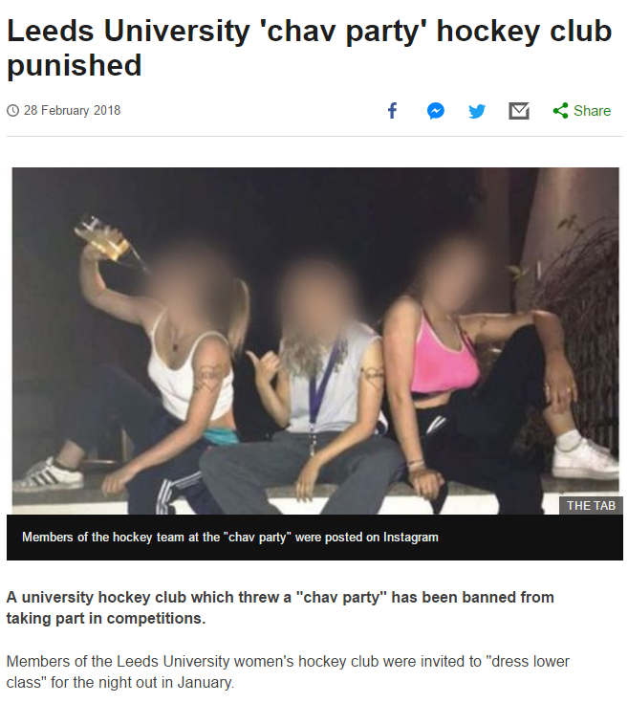
When they go wrong…
Notes:
Fancy Dress themes
Songs
White tshirt socials

Slide 12
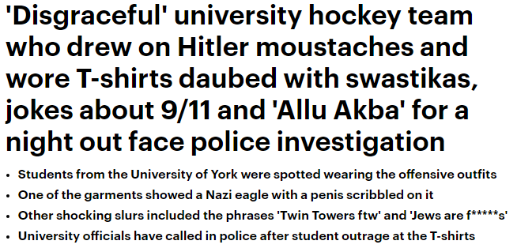
White t-shirt socials
Can you trust your club?

Slide 13
Beer Circles
Beer Circles are allowed as long as:
there is no pressure for a student drink
there is a duty of care to individuals by the senior members of the club
The club do no exhibit forms of anti-social behaviour and comply with venue rules
You do offer ‘dry’ events and socials as alternatives

Slide 14
Who went out last night?
http://www.bbc.co.uk/radio1/games/boozecalculator/#start

Slide 15
Responsible drinking
We’re not saying don’t drink, but please do so safely
No drinks quotas
Don’t force feed anyone alcohol
If someone says no… leave them be.

Slide 16
Dry Socials
… they don’t have to be boring!
Use them as a fundraiser, or team building session.
Any ideas of Dry Socials that you have run in the past?

Slide 17
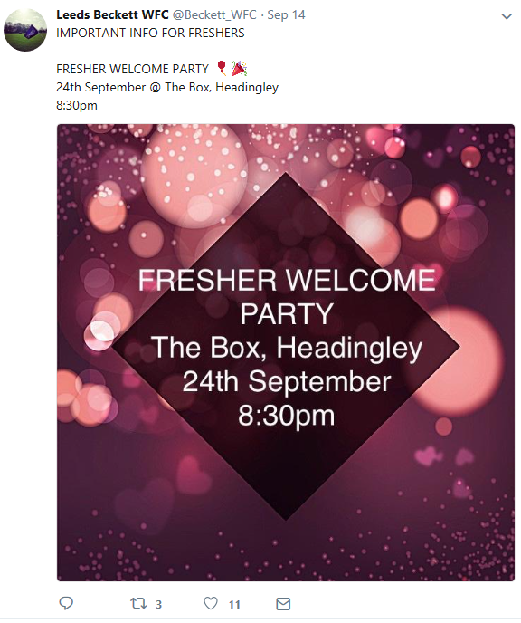
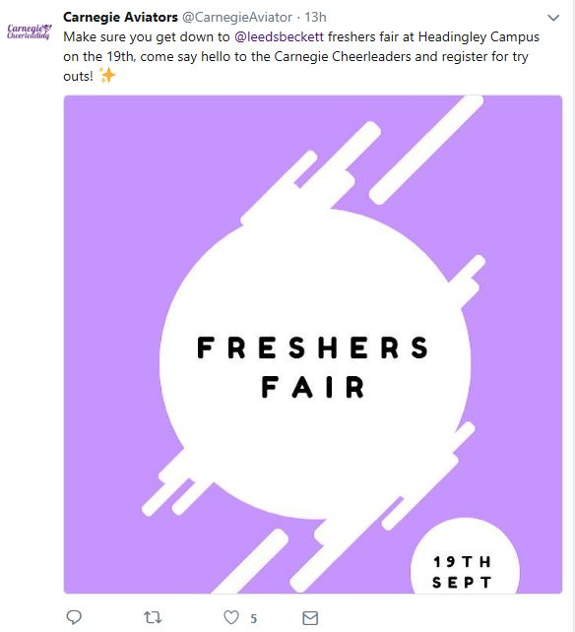
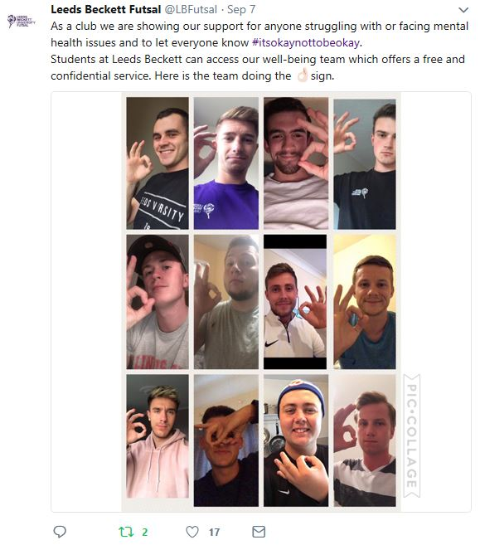
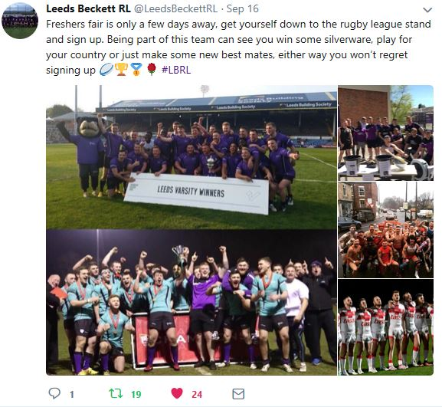
Promoting your activity

Slide 18
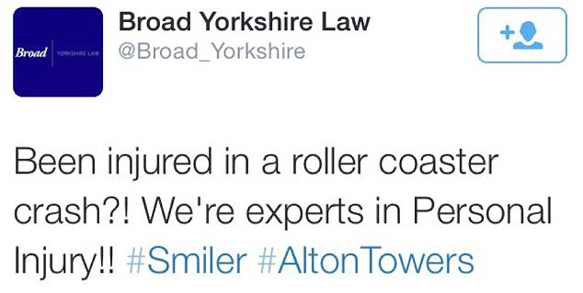
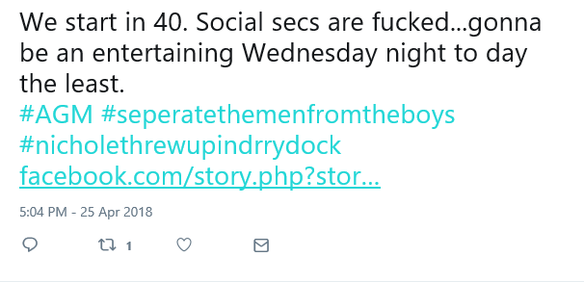
How not to promote

Slide 19
Common Sense Content Check
Does your post contain:
Profanity
Nudity
Inappropriate use of the Beckett logo?
Controversial content
Excessive alcohol references
…Then don’t post it!

Slide 20
Tour

Slide 21
Tour
No University endorsement due to its nature, i.e. it’s not an official sports tour.
We are currently working with ILoveTour to limit the amount of drink-related incidents pre and post-tour
We had some bad publicity around tour a few years ago due to the departure points in Headingley.
‘What goes on tour, stays on tour’?
Definitely not!

Slide 22
Tour Tops
Should not be University Branded
Should not be offensive to other members of the public.

Slide 23
Welfare

Slide 24
Disclosure
One of you club members comes to you on a night out and tells you they’ve just been sexually assaulted by another member.
It’s early in the morning and you’ve had a few disturbing Whatsapp messages from a club member telling you they’ve been self harming. They don’t want anyone to know about it but you.
A parent of one of your members gets in touch with you saying they are worried their child is drinking too much and asks you to find out what they have been doing.
What would you do immediately and in the long term to support this member?

Slide 25
Disclosure: Key Facts
Don’t give advice you’re not qualified to give! Just be there to listen!
Encourage them to contact the Student Wellbeing Team www.leedsbeckett.ac.uk/studenthub/student-wellbeing-team or to the support networks in your handout.
In an emergency on Campus call Security 0113 812666 or off campus the emergency services (999).
You cannot share information disclosed to you unless it’s life-threatening/involves a threat to someone U18
Only the police can investigate sexual/assault. Just support but don’t judge or get involved!
If you’re not sure what to do you can speak to Wellbeing/support networks as long as you don’t disclose the personal details of the individual involved.

Slide 26
Consent
It’s as simple as tea!
https://www.youtube.com/watch?v=fGoWLWS4-kU

Slide 27
Consent: Key Facts
Consent is:
Communicated explicitly
Voluntary
Retractable (people can change their minds)
Recognition of equality and respect in any kind of sexual encounter or relationship.
Consent is not
Something that you can assume is given
Something that someone can give when they are asleep or incapacitated
Something you can coerce or trick someone into
An automatic right if you have been given consent previously, or if you are in a relationship
Taking, sending, or sharing sexual images without someone’s agreement
"There is no place here for behaviour which undermines the dignity and human rights of other members of the community. None of us should adopt such behaviours, and none of us should accept or condone them. That is why I support and endorse the Zero Tolerance movement here at our university."
Professor Peter Slee, Vice Chancellor

Slide 28
Zero Tolerance & Bystander Training
Leeds Beckett and Leeds Beckett Students Union are taking a stand against Sexual Harassment and Violence and are working to embed a zero tolerance culture across campus and in our community.
We have a dedicated Zero Tolerance website and video
We will be offering ‘Bringing in the Bystander’ Training to all AU Members and Facilitator training for Club Officers.
Take the Pledge - Over 1000 individuals, teams and businesses have joined us in ‘Taking the pledge’ to support the Zero Tolerance campaign.
We want AU Clubs to be an example of good practice leading the way with Zero Tolerance.

Slide 29
Concussion
Concussion protocols now in place for all athletes.
If an athlete receives a head injury they should:
Be removed from play and given first aid.
Report the injury to S&AL staff and complete the relevant paperwork.
Have a minimum 19 day stand down from training and competing (23 for under 19s)
Get a Medical practitioner’s authorisation to return to play (physio or other).
Complete paperwork in the office so return to play authorisation can be given

Slide 30
Inclusion

Slide 31
Inclusion: Disability
Have you considered of and how you can make your sessions disability friendly?
Can you promote your club as disability friendly on you communication channels?
Are your members welcoming to students with disabilities?
Have you considered the barriers faced by disabled member to joining your club – can you combat some of these?
Psychological Barriers
Physical Barriers
Logistical Barriers

Slide 32
Inclusion: Disability
Useful Resources:
Sport England: Club Matters
Activity Alliance
Leeds Beckett Disability Advice
Facebook – Leeds Disability Sport

Slide 33
Inclusion: Trans – Awareness
"Sex" refers to the biological and physiological characteristics that define men and women.
"Gender" refers to the socially constructed roles, behaviours, activities, and attributes that a given society considers appropriate for men and women.
World Health Organisation (http://apps.who.int/gender/whatisgender/en/)

Slide 35
Inclusion: Trans Awareness
Laws & Regulations
Most UK sporting bodies now follow very similar regulations.
BUCS recommends:
Follow the regulations of the sport’s governing body
Trans men taking testosterone should compete as male
Trans women can compete as female if they have been taking testosterone blockers for 12 months

Slide 36
Inclusion: Trans Awareness
How can I make my Club and Members Trans Friendly?
Describing/addressing people – in person or by phone:
Use gender-neutral language/descriptors
Avoid ‘Sir’ and ‘Madam’/’love’ and ‘mate’ / ‘Ladies and gentlemen’
Don’t make assumptions based on voices verify ID if necessary
How to sensitively ask for pronouns:
Just ask: ‘Hello, nice to meet you! What pronouns do you use?’
Invite them by example: ‘Hello! I’m Jo, and I use she/her pronouns.’
Normalise it: Include pronouns in mass introductions/on name badges

Slide 37
Inclusion: Trans Awareness
How can I make my Club and Members Trans Friendly?
Always ask yourself: is it necessary to gender this?
Provide as much clarity and information as possible:
Are trans people welcome? (Include non-binary people!)
Are teams mixed or single-sex?
Who can play on each team? What are the medical parameters (if any)?
What are changing facilities like? Do you have cubicles/gender-neutral options?
What can you wear (especially swimwear: are rash guards allowed?)
Do you have a trans inclusion policy? Is it clearly signposted?
Have club members had training?
All of these factors will affect a trans person’s
decision to participate.

Slide 38
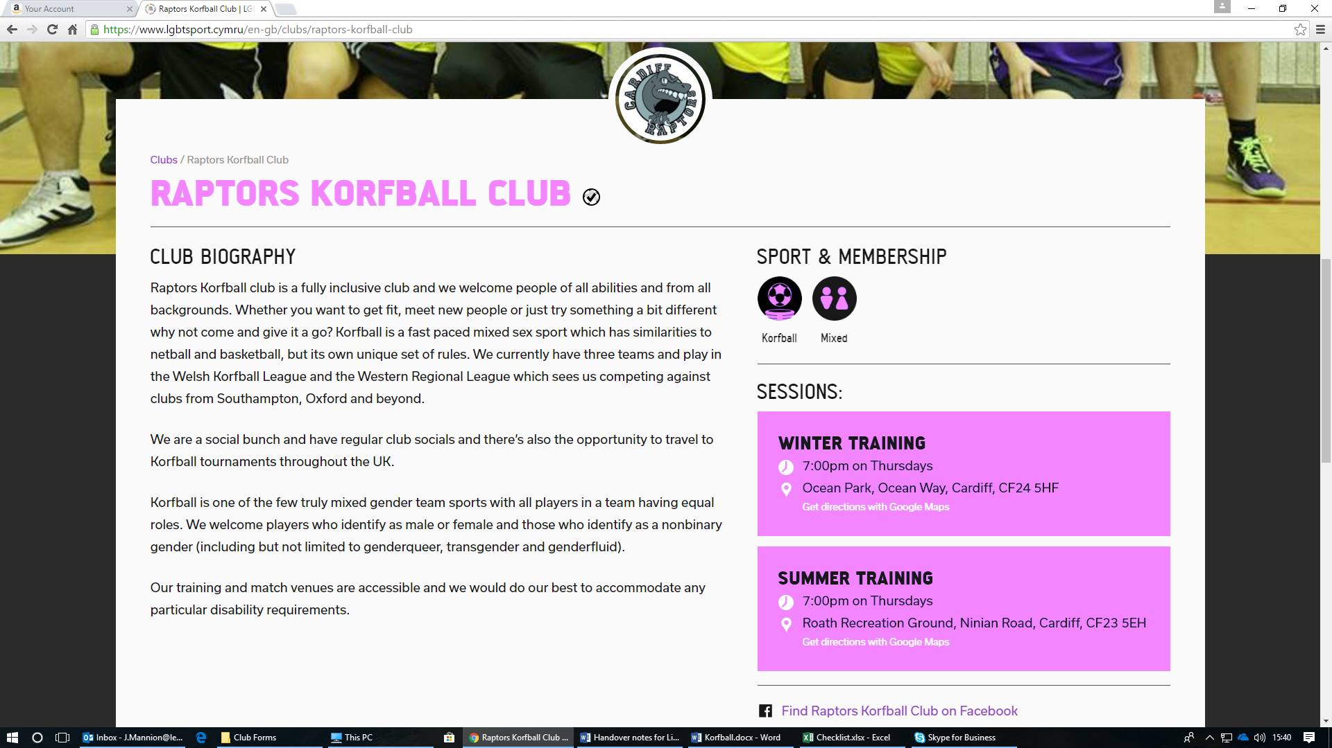
Inclusion: Good Examples

Slide 39
Disciplinary

Slide 40
Incidents
In the past 18 months we have had to deal with . . .
Accusations of bullying and harassment of Beckett and non-Beckett students
Multiple complaints of sports teams behavior on trip and tours away.
Complaints about public nudity, urination and littering
Fights at Varsity
Inappropriate and offensive social media posts
Complaints from lecturers about Clubs conducting initiation activities in lectures
Complaints from the SU/local bars about Club conduct
Poor conduct and abuse of officials at matches

Slide 41
Code of Conduct
Every AU Member signs up to the anti-social behavior policy when purchasing a membership.
You can find a copy of this on the ‘Club Officer’ section of our website.
Written inline with the University’s Student Code.
You can help ensure your members don’t breach the Code of Conduct.

Slide 42
Consequence
Possible consequence of poor behavior can include:
Suspension/removal of indiviudal from Clubs
Removal of committee members from their roles/the club
Club being put into special measures
Teams being banned from attending fixtures/Varsity/BOTN
Suspension of club financial accounts
Suspension/Dispansion of the Club
Academic investigation and potential disciplinary action
Police investigation and potential prosection
Expulsion from the University
All of the examples above have happened to our Club Members!

Slide 43
Any questions?

