Slide 1
Club Officer Training - Part 2
Friday 14th September

Slide 2

Welcome!
Introductions
H&S
First Aid Course
AU Exec

Slide 3

Memberships

Slide 4
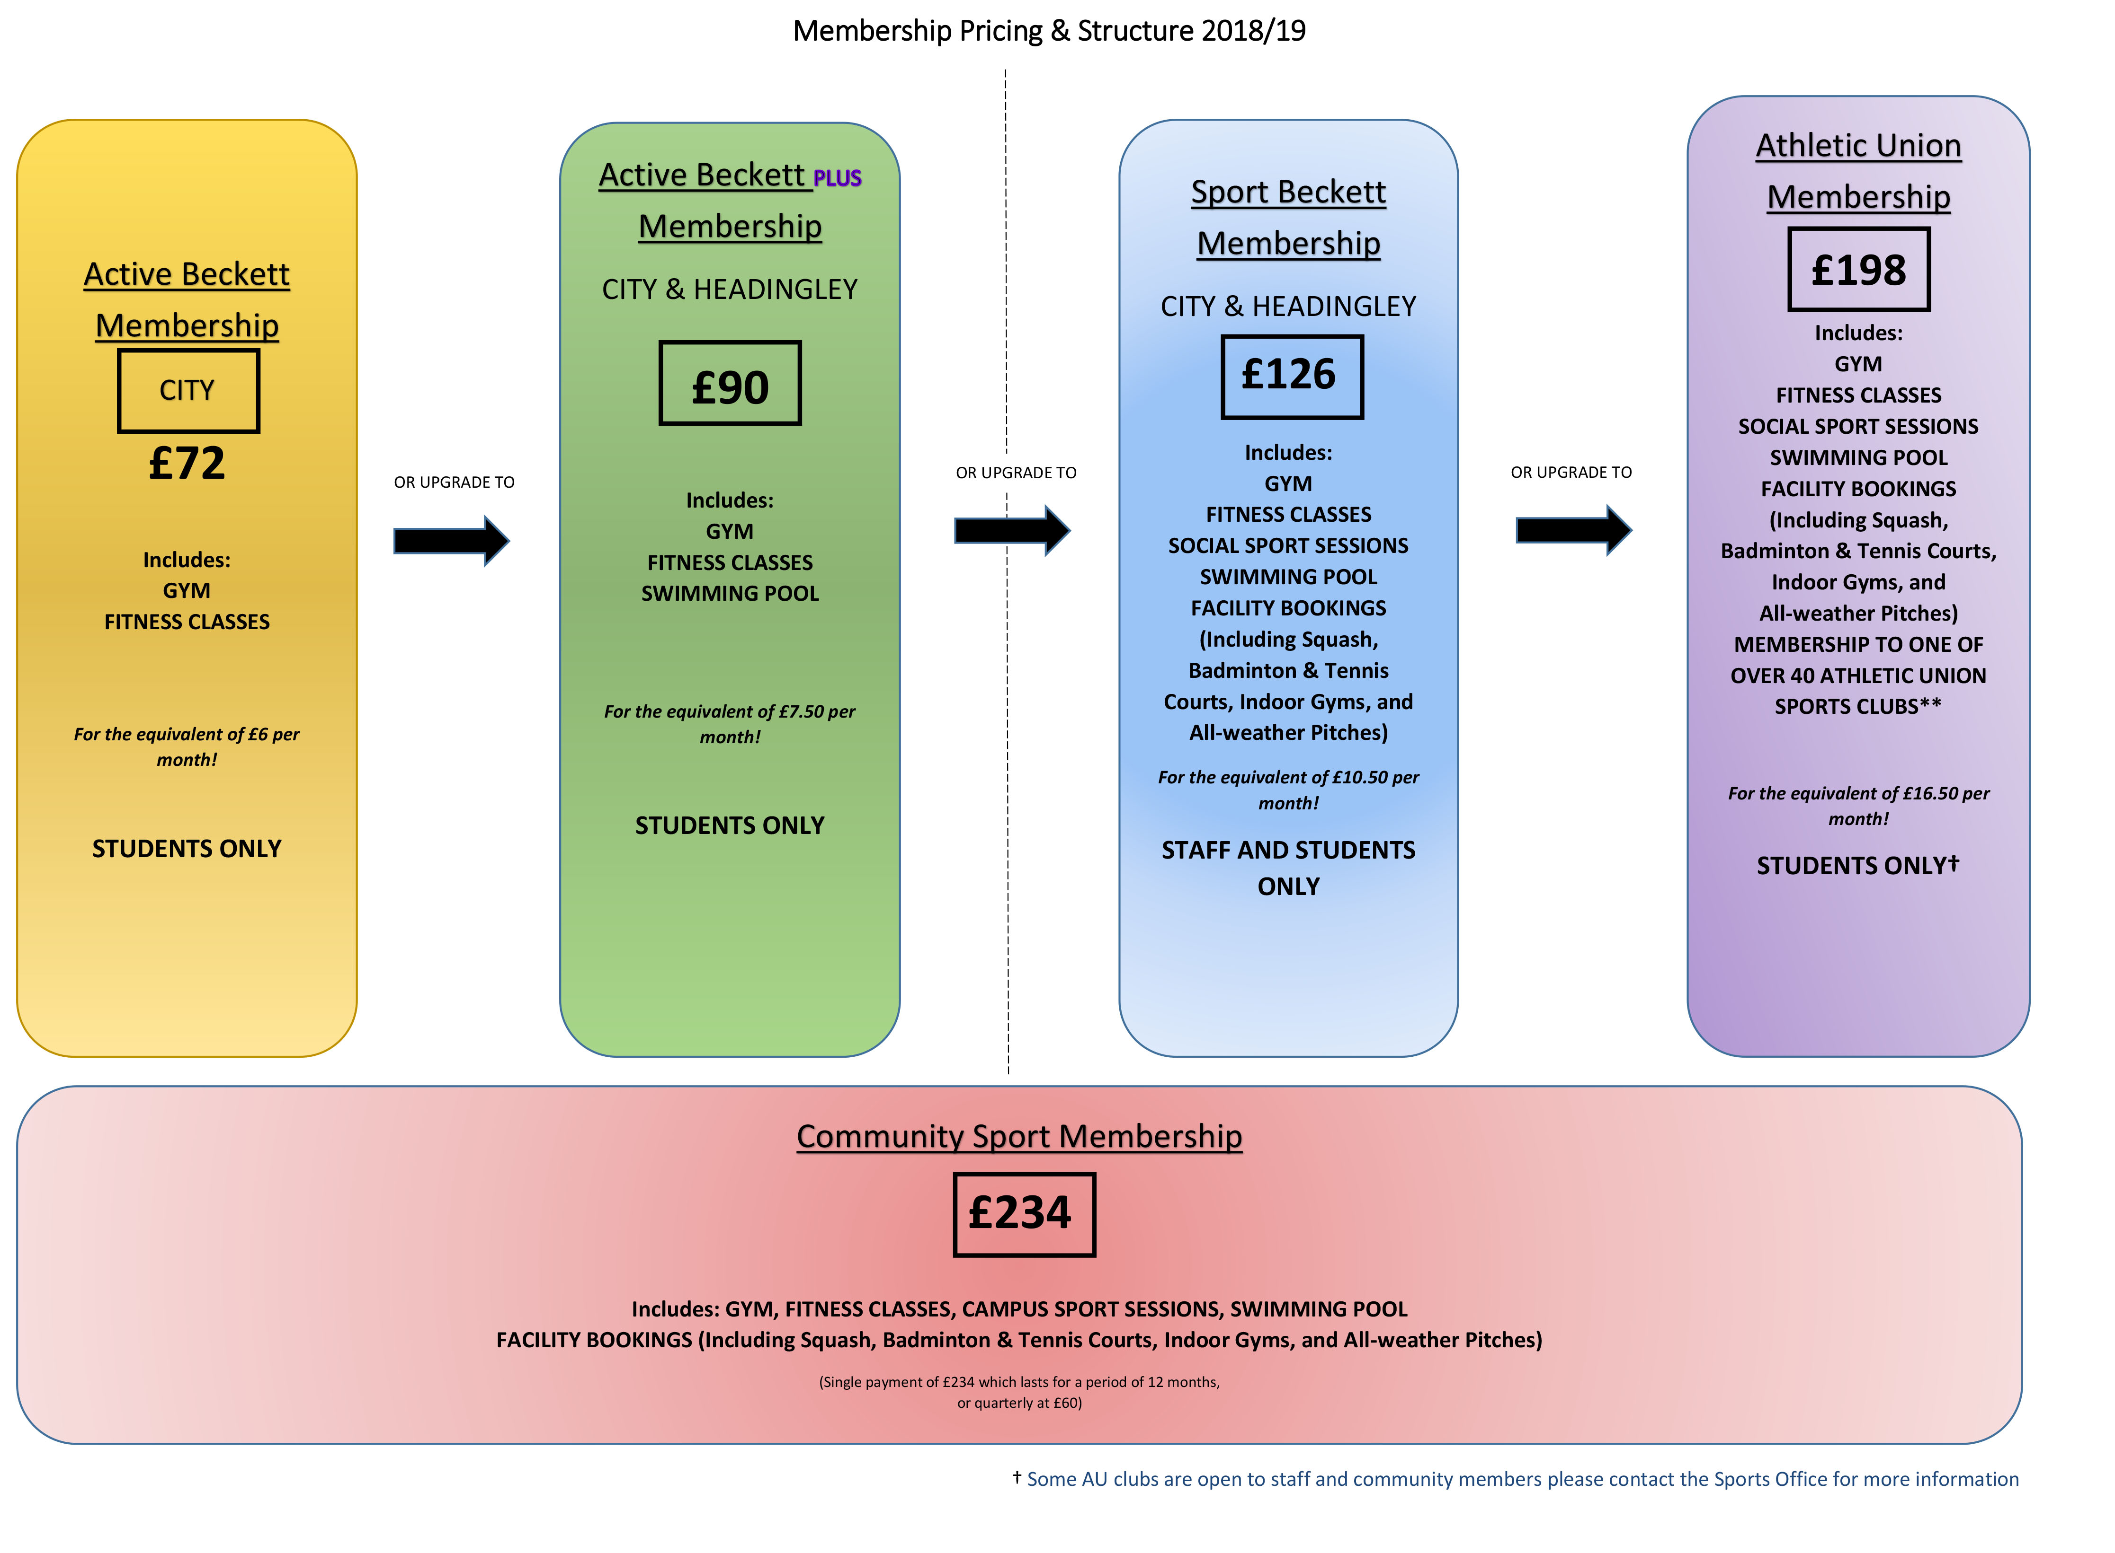

Slide 5


Memberships
All 1st year Undergraduates get a free Active Beckett Plus Membership!
It’s just £108 for 1st year’s to upgrade to an AU Membership
Access sessions via reception or using the quick scan machines in reception (HC only).
Please do regular membership checks – everyone should have a ticket.
We will do spot checks throughout the year.
REMEMBER – it’s in your interest to have a full membership!

Slide 6
Membership – what it includes . . .
Essential kit or equipment items
BUCS or authorised Non-BUCS entry fees
NGB affiliations
Transport to away fixtures
Coaching
Strength and conditioning
Training costs (pitch/ venue hire)
Priority use of University sports facilities – 68% of all bookable time
Accommodation subsidies
Classroom access for meetings
Medical Insurance
Staffing support

Slide 7
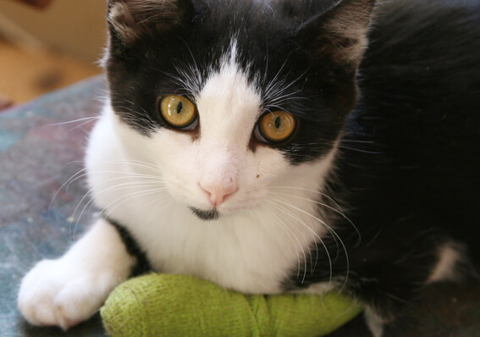

Insurance
All paid AU members are covered
Helps to cover cost of loss of earnings, hospital stays, study issues relating to an injury etc.
Need medical proof of injury to claim.
To claim or for questions please speak to a member of the Sports Office
PLEASE SHARE THIS INFORMATION WITH YOUR MEMBERS!!

Slide 8

Varsity

Slide 9
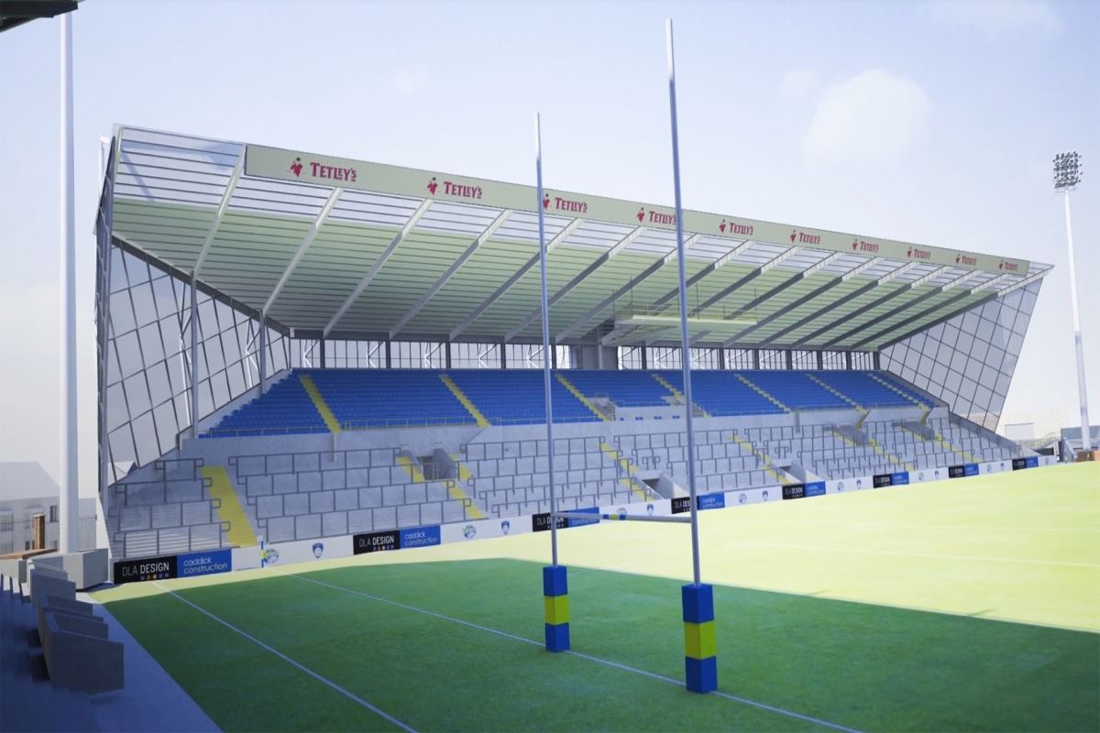
We’ve got the South Stand back!!
3rd October, KO 7pm
5000 tickets, all standing!
Buy from sports office or online via
www.leedsvarsity.com
Rugby Tickets £15, Afterparty (Pryzm) £5
Black cards don’t work
Club Officers can get yours today!

Slide 10

Important things to remember!
Get there early (before 6.45pm)
Don't bring any contraband into the stadium
If you turn up very drunk you will be refused admittance
No umbrellas or large bags!
Don't turn up in large groups
No offensive chants (they won't hear you!)
No throwing missiles (£1000 fine)
No streaking (£1000 fine)
No pitch incursions (£1000) fine
Be considerate of local residents
Set a good example!
Leave the cones alone! (146 @ £4)

Slide 11
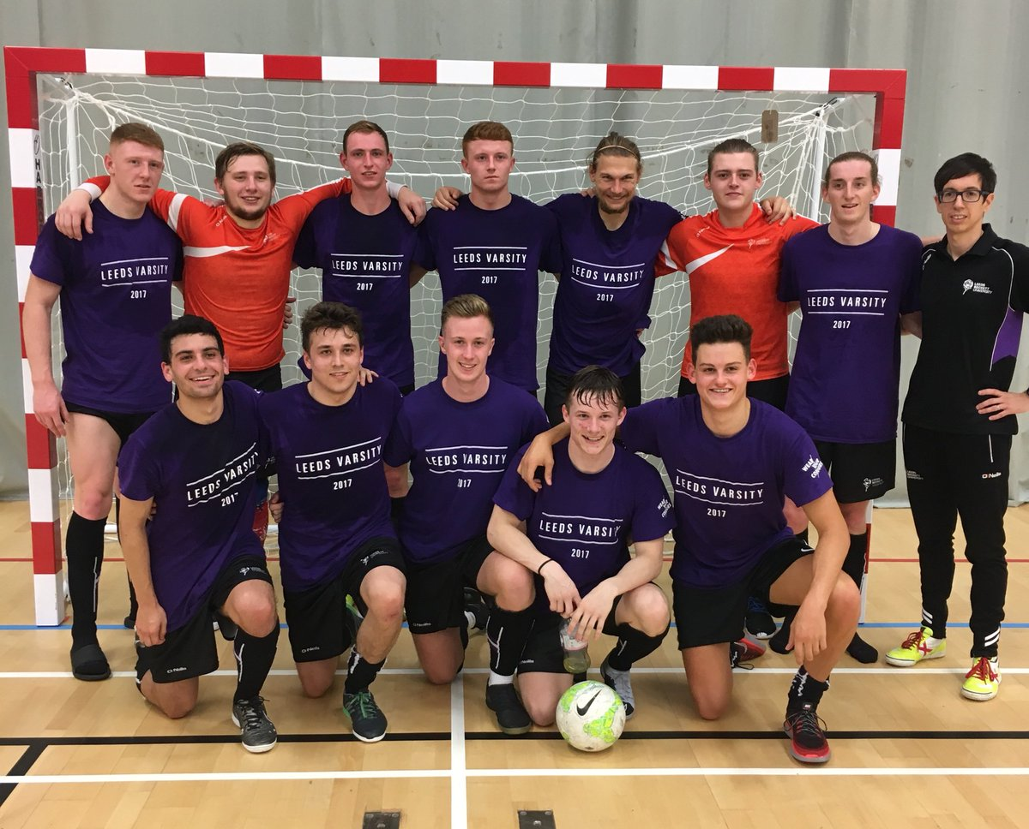
Varsity Futsal
Sunday 30th September 11am, Blue Hall
Come support your team!

Slide 12
Varsity Openers

Slide 13
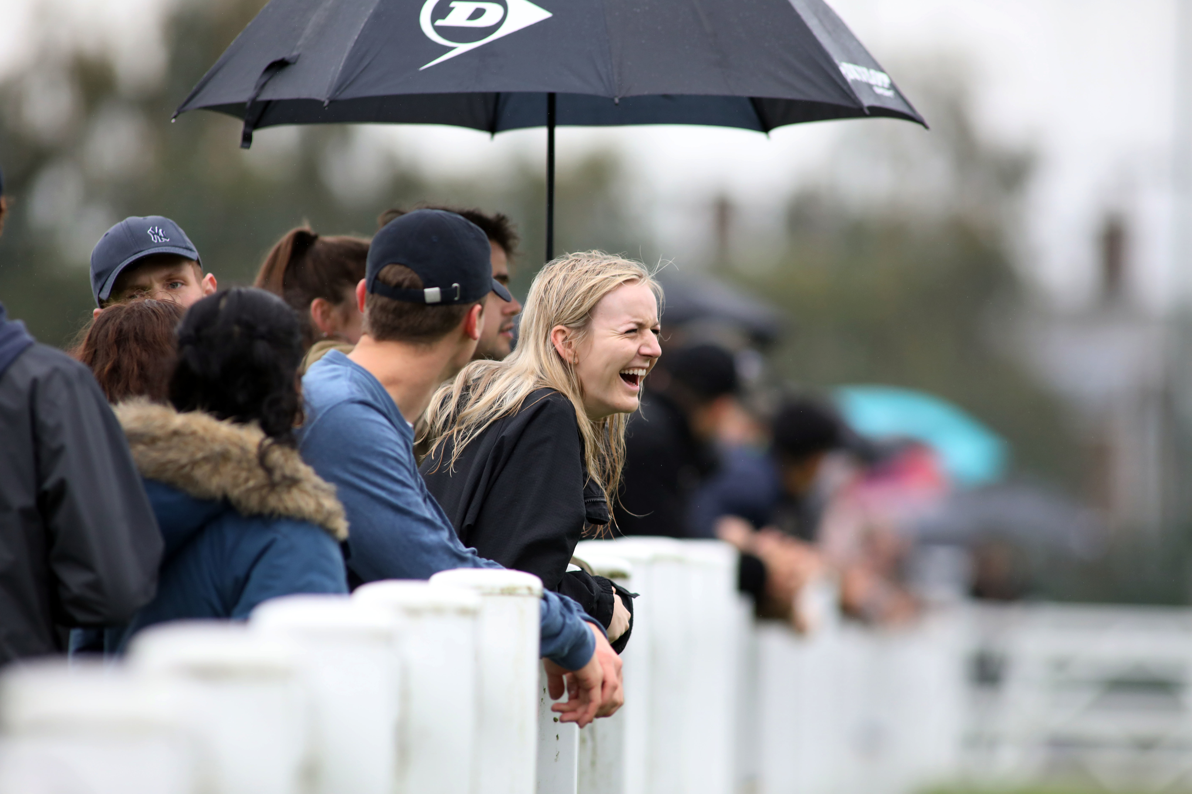
Varsity Festival, 3rd October
Athletic Pavilion
12-5pm
BBQ
SU Bar
Cake Stall
Face painting
DJ Society
Lots of great sports fixtures
Don’t bring your own alcohol
Bag checks will be done
No alcohol allowed inside

Slide 14
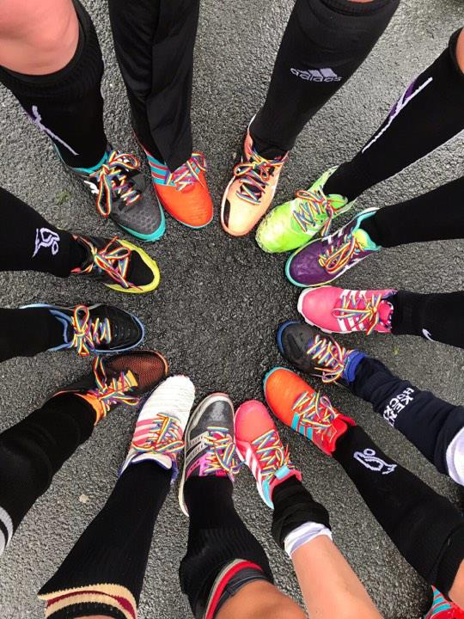
Rainbow Laces
100 pairs available
First come first served
Let Jo or Lisa know if you want some!
Take lots of pics and tweet them out!
Use @Stonewalluk

Slide 15
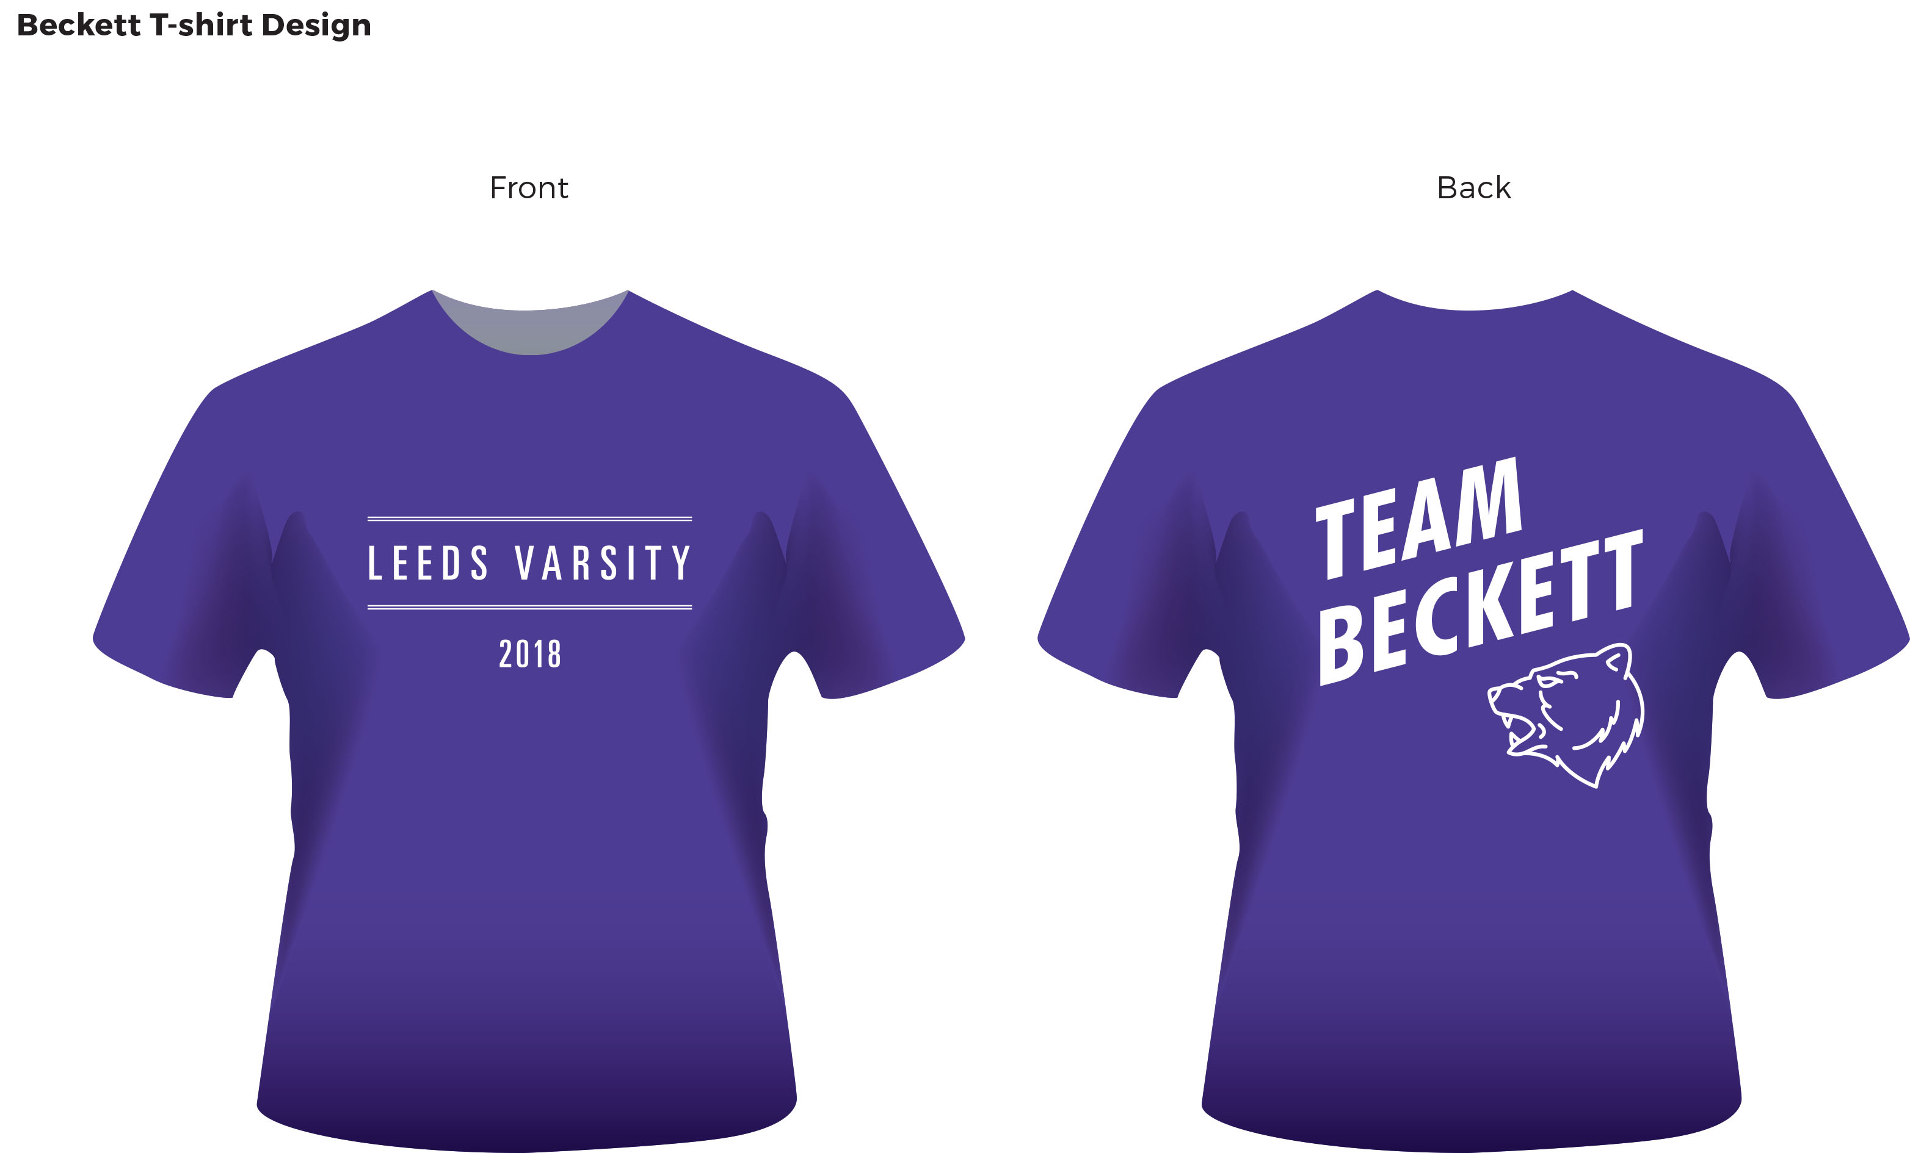
Varsity T-shirts

Slide 16


Slide 17



Get Social!
  @leedsvarsity18
  #leedsvarsity #wearyourcolours
  Leeds Varsity – Beckett Fans
  leedsvarsity

Slide 18
Social Sport
Dan Stanley

Slide 19
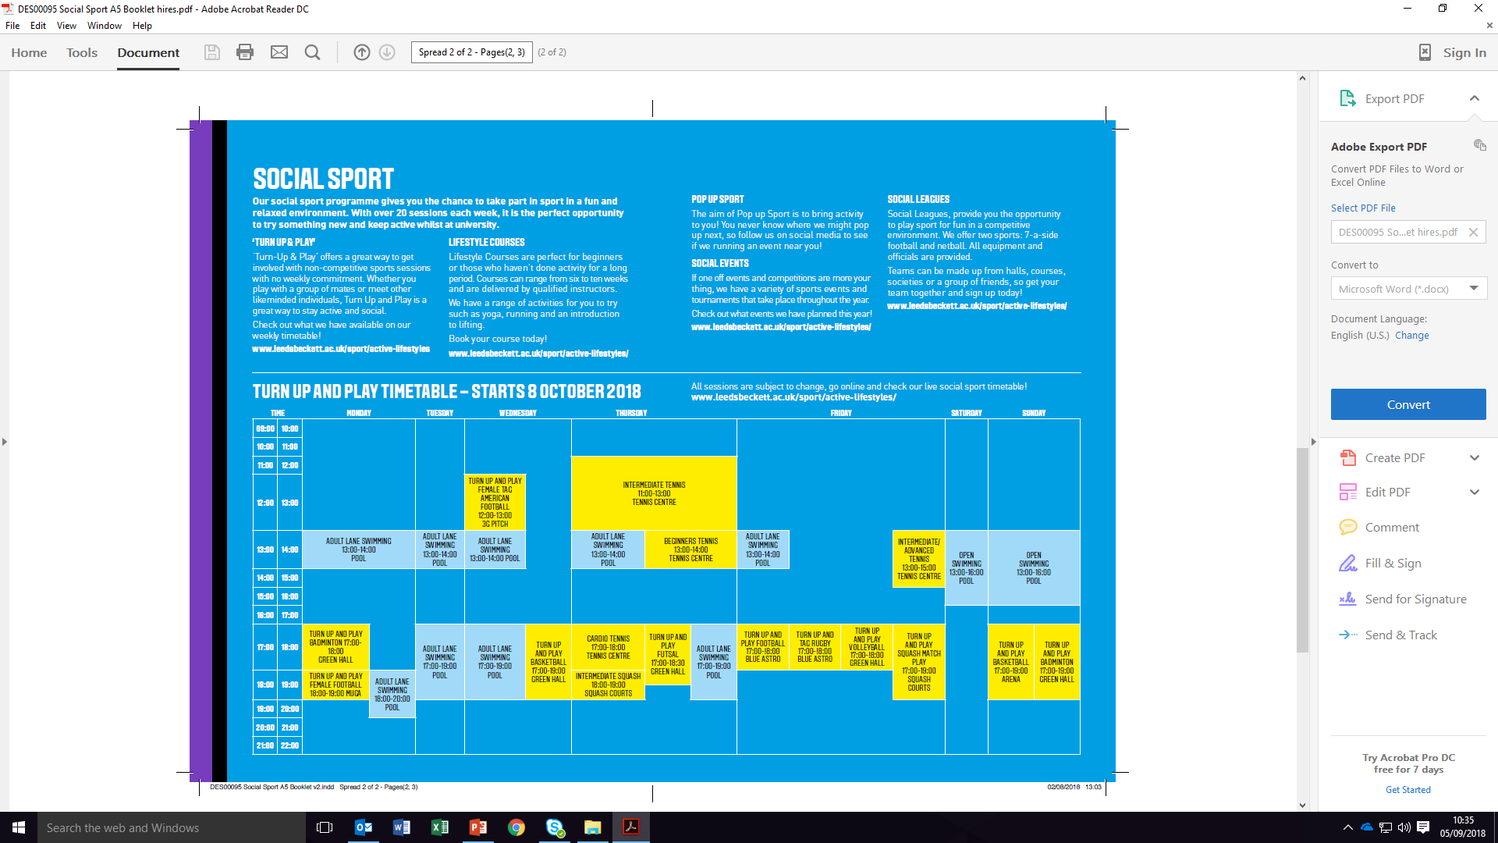
Social Sport – Turn Up and Play

Slide 20
Social Leagues
Play sport for fun in a competitive environment.
We offer two sports: 7-a-side football and netball.
All equipment and officials are provided.
Teams can be made up from halls, courses, societies or a group of
friends.
From as little as £2.20 per game

Slide 21
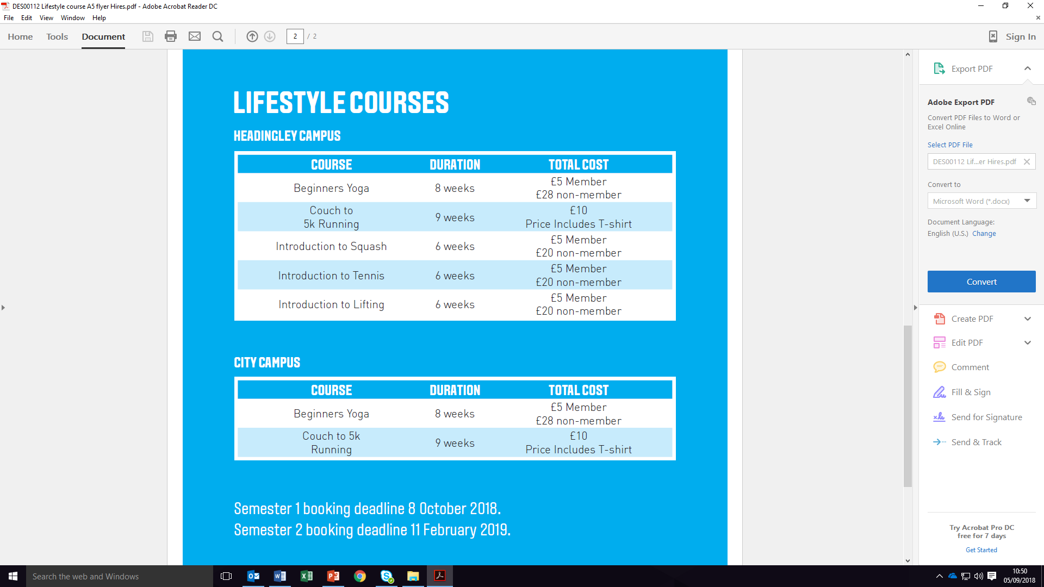
Lifestyle Courses

Slide 22
Leadership Academy
Employability and leadership programme.
SPORT ACTIVATORS
Activators need to be committed & interested in sport & getting our students engaged.
Interested in career development and enhancing their CV and employability skills.
Activators are responsible for delivering our Social Sport programme.
COACHING SCHOLARS
A select number of sports coaching scholarships are available
Delivery across our Social Sport programme, or as part of the Carnegie Junior Sports Academy.
Must have prior experience of coaching and/or hold a coaching qualification (minimum level 1)
Sports available include: Athletics, Tennis, Squash and American Football.
STRENGTH AND CONDITIONING INTERNS
Assist the delivery of S&C sessions to focus sport teams, scholarship athletes & TASS (Talented Athlete Scholarship Scheme) athletes supported by the university.
Additional benefits available such as CPD financial support, kit and sports membership.

Slide 23
Fresher’s Week

Slide 24
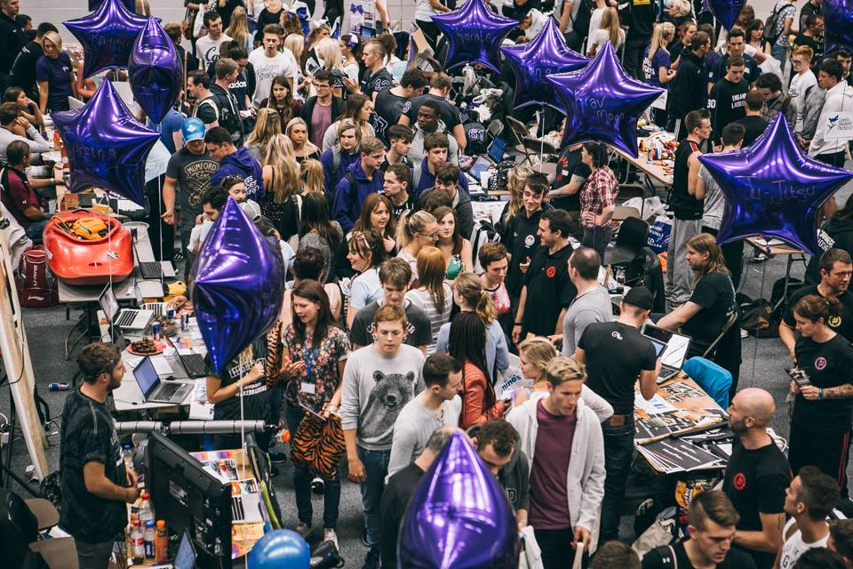
Fresher’s Fair
Wednesday 19th September
10am – 4pm
Green Hall
You must be set up for 9.30am
Check out the hints and tips in your handbook

Slide 25
Fresher’s Fair
GDPR
Only collect what is needed – what do you actually need?
It can only be used for the purpose collected (i.e. for inviting to your club)
You must store data securely
Do not share data with third parties (i.e. sponsors, NGBs etc)
It must be destroyed after use and kept no longer than necessary
If you have any questions or concerns please speak to the Sports Office

Slide 26
Mini – Fresher’s
When: Monday 24th September – 6-8pm
Where: The Vault, Kirkstall Brewery
Contact Lisa to reserve a space!

Slide 27
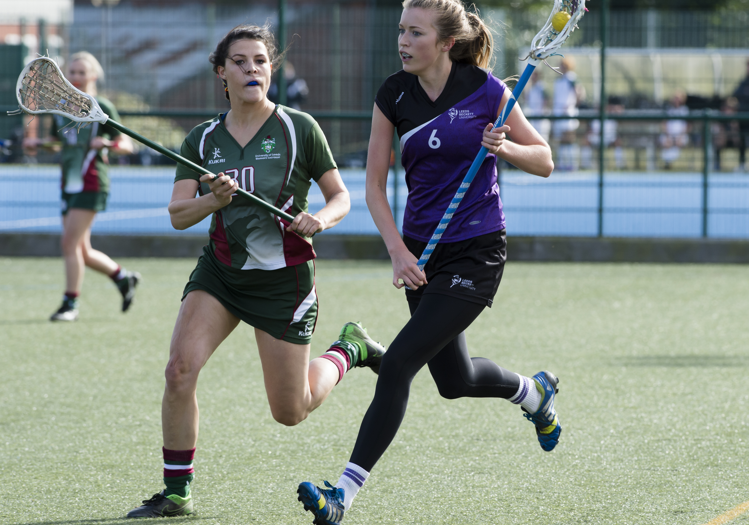
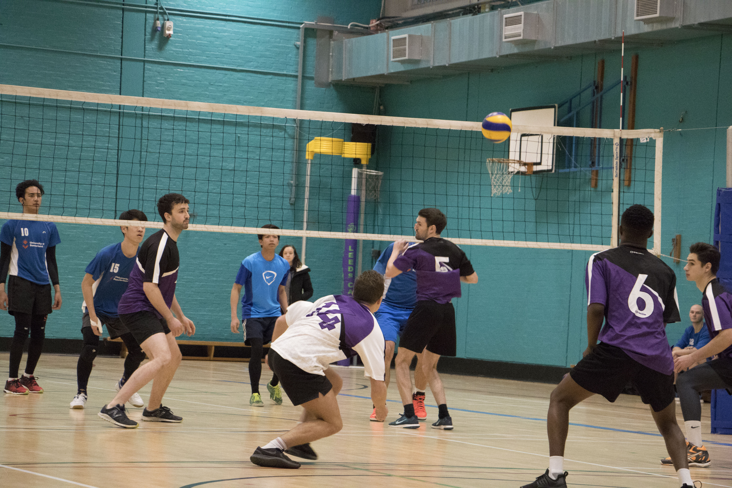
Trials & Tasters
Please ensure your trials and tasters are listed on the pack issued to you.
If not – email lisa.mccormick@leedsbeckett.ac.uk ASAP
All taster sessions will be listed on the SU GIAG website.

Slide 28
Breakouts
Group 1 – Competition & Events - Caedmon G13
Group 2 – Finance, Transport & Accom – Macaulay G11
Group 3 – Club Promotion – Caedmon 124
Group 4 – Club Development Mark – Caedmon G05

