Slide 1

Practice supervisor & Practice Assessor - Transition for PRACTICE TEACHERS & mentors
NMC (2018) Part 2: Standards for Student Supervision and Assessment
Adapted for use by Leeds Beckett University March 2020
Developed by PAN Midlands Yorkshire and East Practice Learning Group for use and amendments under the Creative Commons licence. Details at https://creativecommons.org/licenses/by-nc-nd/3.0/

Slide 2

What is new for practice teachers & Mentors?
In addition to the traditional 3 year University based student nurses
New learners:
Associate/ assistant practitioner roles - employer led; in- house
Nursing Associates – NMC regulated (education; practice standards; register; code) – employer “owned”
Apprentice Nurses - 4 years; same curriculum and NMC standards as traditional student nurses – employer “owned”
Other health apprentices –non nursing
E – Pad Mindland, Yorkshire and East – new PADs to reflect new standards on Pebblepad – for ALL nursing students

Slide 3

Standards for education and training
Notes:
Explain overview of new NMC standards.
Part 1 Standards framework for nursing and midwifery education (for all NMC approved programmes)
Part 2 Standards for student supervision and support (the new approach to learning and assessment which replaces mentorship)
Part 3 Programme standards with detail relevant to each approved programme: entry requirements, length, hours and the award etc. (so far NMC have published Standards for pre registration nursing programmes and Standards for prescribing programmes. Building on this with a publication for each approved programme)
The proficiencies for nursing and midwifery professions (including nursing associates). As with the programme standards, so far published the nursing proficiencies, and adopting the Royal Pharmaceutical Society Competency Framework for prescribing.

Slide 4
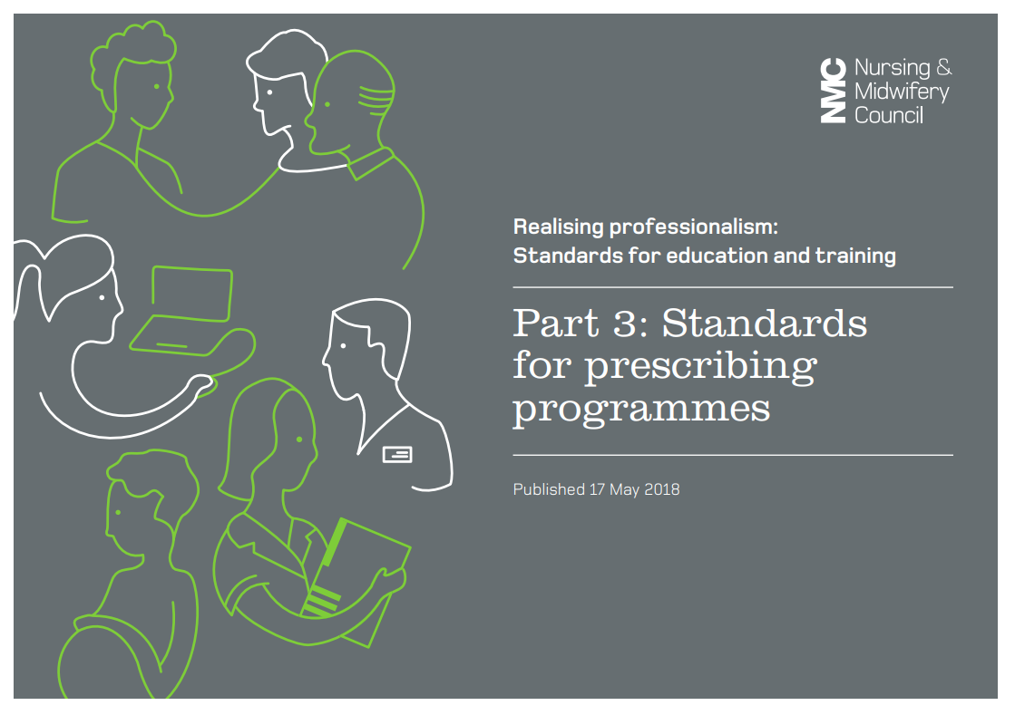
Other relevant courses requiring Pa/ps

Slide 5



NEW Roles for student supervision and assessment
Any registered healthcare professional after preparation
Continuity needed to measure student progress
Can assess some skills / outcomes and will feedback to Practice Assessor on the student
Expectation that all RNs and MWs in Leeds will take on this role following preceptorship
Practice Supervisor
NMC registered (not field specific)
Current, suitably prepared and supported
Must observe student in practice
Assess and confirm achievement
Do not supervise and assess the same student
Expectation that current up to date mentors in Leeds will take on this role once prepared
Practice
Assessor
Academic staff, NMC Registered, not field specific
Current, suitably prepared, supported
Collate and confirm achievement in practice in conjunction with PA to enable student to progress to next stage of the programme
University lecturers in Leeds
Academic
Assessor
Notes:
An expectation that all mentors transition to the role of practice supervisor and in many cases also into practice assessor.
You cannot be a practice supervisor and a practice assessor to the same student at the same time.
Mentor role is separated
AA identified in the students electronic documentation
Communication essential between PA and AA, this can be done in various ways i.e. electronic, telephone, face-to-face if required

Slide 6



example model
Example Placement
Students will work with multiple Practice Supervisors.
Practice Supervisors will feedback to students Practice Assessor who will make assessment decision.
Practice Assessors will liaise with Academic Assessors to make decision on students progression to the next stage.
Notes:
PA in each placement receives feedback from the PS and then academic assessor tracks student through each placement, receives feedback from PA in each placement and in final summative placement discusses student achievement and progression with PA there.
Key to successful implementation any model for practice supervision and assessment (regardless of placements) is that all PS are aware of the learning objectives for each spoke/ shift
Documented throughout in assessment document records (MYE PAD) which may be electronic, so communication may not always be face to face.
York approx. model:
BASE PLACEMENT 4 WEEKS
2X PLACEMENT EXPERIENCES OF 2-3 WEEKS EACH
1 WEEK BASE PLACEMENT
2X PLACEMENT EXPERIENCES OF 2-3 WEEKS EACH
4 WEEKS BASE (END OF YEAR SUMMATIVE ASSESSMENT)

Slide 7





Potential Benefits of New Roles
Separates supervision and assessment roles
Everyone will have an input into assessment = increased consistency in judgements
Improves interprofessional working
Less prescriptive e.g. end of 40% mentor student working & Sign off mentor requirement
Supporting student learning becomes everyone's responsibility
You can be both a practice supervisor and a practice assessor, but not to the same student

Slide 8
Roles and responsibilities of the practice assessor
Conduct assessments and ensure assessment decisions are informed by feedback from practice supervisors
Make and record objective, evidence based assessments on conduct, proficiency and achievement, drawing on records, observations, student reflection and other resources
Maintain
Maintain current knowledge and expertise relevant for proficiencies and programme outcomes
Work in
Work in partnership with academic assessors to evaluate and recommend progression
Opportunities
Have sufficient opportunities to periodically observe the student across environments
Conduct
Make and record
Notes:
Each practice assessor is responsible for the assessment and confirmation of the achievement of proficiencies and programmes outcomes in practice learning for the student(s) they are assigned to, for the period they are assigned to them.
A good assessment is evidenced based, objective and fair, taking into account a variety of views and inputs, and student diversity, such as different learning styles, cultural backgrounds and communication styles. The practice assessor should take into account the student’s history of achievement and their achievement across theory and practice.
Assessment should be continuous throughout the time in which a practice assessor is assigned to a student. The practice assessor should be up to date on the progress of the student they are assigned to; collation of information on a student’s performance should be managed in a way that enables this.
Feedback to the student about their achievement, and collaborating with them to review possible areas for improvement also forms a fundamental part of the assessment process.
Must not be a practice assessor and supervisor for the same student
Sources of evidence can include the following:
Direct observation of the student
Communication with practice supervisors
Student documentation, such as a practice assessment document or ongoing record of achievement
Communication with any other practice assessors
Communication with anyone else who may be involved in the education of the student
Communication with the academic assessor
Student self reflection
Communication and an ongoing relationship with the student

Slide 9


Roles and responsibilities of the practice supervisor
Feedback
Raise Concern
Appropriately raise and respond to student conduct and competence concerns and are supported in doing so
Safe and Effective
Support and Supervise
practice supervision ensures safe and effective learning experiences that uphold public protection and the safety of people
all students on an NMC approved programme are supervised in practice by NMC registered nurses and midwives and other registered health and social care professionals
there is sufficient coordination and continuity of support and supervision of students to ensure safe and effective learning experiences
the level of supervision provided to students reflects their learning needs and stage of learning
support and supervise students, providing feedback on their progress towards, and achievement of, proficiencies and skills
Notes:
This is why newly qualified students need this preparation, it’s an expectation all registrants will take on this role in line with the Code.
Locally practice partners have said they would not expect newly qualified staff to take on the role until they have completed preceptorship
Clarify about raising concerns

Slide 10

Roles and responsibilities of the Academic assessor
Make and record objective evidence based decisions on conduct, proficiency and achievements and makes recommendations for progression
Work in
Communication
Enables scheduled communication and collaboration between academic and practice assessors
Collate and Confirm
Make and record
Collate and confirm student achievement of proficiencies and programme outcomes in the academic environment
Work in partnership with a practice assessor to evaluate and recommend the student for progression for each part of the programme
Has understanding of the student’s learning and achievement in practice

Slide 11
Roles and responsibilities of the Student
Engagement
Students must take a key role in their supervision and assessment in practice
Prepared
Prepared for and have a sound understanding of the proficiencies they need to achieve
Feedback and Documentation
Actively encouraged to seek out practice supervisors to support their learning and encourage feedback to be recorded in their PADs
Be Aware
Raise Concern
Be aware of their nominated PA and AA from the beginning of the placement
Know which person they should speak to in the practice area if they have concerns

Slide 12
My colleagues are currently on a SLIP programme (or applying for one) – are they wasting their time?
I am currently a Mentor on mentor register do I need to still update myself and continue with triennial review ?
Yes ! Because:
From September 2020 Year 1 and Year 2 nursing students and some Trainee Nursing Associates at both Leeds Uni and Leeds Beckett will move onto the new standards for supervision & assessment in practice so will need PAs and PSs and As
Year 3 student nurses and some TNAs during September 2020 - 21 will run out on the old standards so will need Mentors and Sign off mentors
Current mentors who are up to date may become Mentors once they have been prepared on the new standards. This will be recorded as a Practice Assessor on the Mentor register
No! Because:
Current SLIP programmes at Leeds Uni and Leeds Beckett have been mapped against new PA standards so will prepare mentors to be both mentors and PAs
Eventually SLIP will be replaced with a Practice Assessor programme

Slide 13
“Practice supervision facilitates independent learning” ( NMC 2018 SSSA page 6)
Practising independently with minimal supervision, leading and coordinating care with confidence
Active participation in care, minimal guidance, performing with increased confidence and competence
Guided participation in care and performing with increasing confidence
End Part 3
End Part 2
Knowledge
Skills
Attitude
Assessment of each component of MYE PAD
Yes or No
End Part 1
Knowledge | Skills | Attitude and values
Notes:
This slide links to the assessment tool in the MYE PAD and therefore creates the link between teaching / learning and the expected level for assessment
Supervisors need to be aware of what level the student is aiming for in order to be able to identify appropriate learning goals at the correct level.

Slide 14

Equality & Diversity
Equality Act 2010
Protected Characteristics
Reasonable adjustments to support learning and assessment in practice
Legal standards of competence (e.g. NMC specified hours in practice) cannot be adjusted
Standards of competence must be achieved to ensure patient safety

Slide 15

The PAN Practice Assessment Document ( e - PAD)
Practice Assessment Document Part 1,2,3
Ongoing Achievement Record
Introduction/
Orientation
Interviews
Initial, midway, final
Professional Values
Episodes of Care - Reflections
Service User Carer Feedback
Skills
Assessment Framework
Practising independently with minimal supervision
1
2
3
Guided Participation
Notes:
Showing that much of the new document will be familiar
The new assessment framework is in 3 parts, moving from guided participation of students at the beginning, to practising independently with minimal supervision
prior to qualifying. This will be in line with similar assessment processes already in use.

Slide 16
MYEPAD /OAR: documentation and assessment
Practice Supervisor
Practice Assessor
Completes:
Can complete initial interview per placement
Mid-point professional values
Contributes to assessment of proficiencies based on scope of practice in liaison with the Practice Assessor
Signs off Service User Feedback
Provides feedback interprofessional working page
Completes:
Can conduct/ confirm initial interview per placement
Mid-point and final interview per placement
Assessment and confirmation of proficiencies
Final professional values per placement
Episode (s) of care
Medicines Management
Completes OAR at end of each placement & progression point
Completes:
Action Plan (if required and with Practice Assessor)
Signs off Final Interview if required
Signs off OAR at end of each placement and progression point
Academic Assessor

Slide 17
Raising concerns
What should you do if you are concerned about:
Performance
Absence
Conduct
Potential fitness to practice
Communication – student & link lecturer
Documentation
Adherence to timeframes ?

Slide 18

Giving feedback
Take time to give feedback
Think about the structure first
Focus on the positive but also highlight what can be improved
Give specific examples to illustrate the feedback and make it objective
Be non judgemental
Give the learner time to respond
Link to assessment criteria / expected level of progress if possible
Are there any issues for you in giving feedback?

Slide 19
Reflection / Revalidation
After this session take some time to reflect on how this new role will impact on your current way of working
Add this reflection to your certificate of attendance from this session.
Ensure you evidence your work with learners within your revalidation documentation.
This workshop equates to two hours of participatory CPD
You are required to complete an update each year
Triennial Review documentation will now be part of the revalidation process

Slide 20

Any questions

Slide 21
Further information
Pan Midlands Yorkshire and East Practice Learning group website www.myeplg.ac.uk
NMC SSSA Supporting Information on their website
www.nmc.org.uk/supporting-information-on-standards-for-student-supervision-and-assessment
University of Leeds and Leeds Beckett University placement website https://practiceplacements.leeds.ac.uk/ - click on Nursing and Midwifery
Your Link Lecturer
Your organisation’s Practice Learning Facilitator(s) or Practice Learning Team

