Slide 1
Neurodiversity guidelines for students and staff in education and practice
RCN Education Forum : Chair – Dr Sarah Burden, Vice Chair & Project Lead Dr Rachael Major
Senior Lecturer Institute of Health and Social Care Studies, Equality Diversity and Inclusion Lead
Post Graduate Programmes and Academic CPD Lead, The Guernsey Institute.

Slide 2
Purpose of workshop
Outline a Royal College of Nursing Education Forum project focusing on developing Neurodiversity guidance for Employers, managers, staff and students.
Raise awareness of resources to support Neurodivergent nurses, nursing support workers and nursing students in practice settings.
Provide a forum for discussing how to support and celebrate neurodiversity in practice.

Slide 3
Terminology
Neurodivergent: term for an individual whose mind works in different ways to what is typical
Neurodiversity:
The natural diversity of all human minds and encompasses both neurodivergent and neurotypical individuals - Singer 1988
Neurodiverse: a group of individuals who represent the spectrum of neurodiversity
Neurotypical: having a mind that functions within what society terms as typical or common
However, Neurodiversity has also become a movement initially lead by the autistic community and now encompassing a range of neurodevelopmental conditions
Walker, 2023

Slide 4
What is Neurodiversity
Phrase first introduced in 1980’s by Judy Singer
Neurodiversity is a term used to describe a range of neurological differences including:
Dyslexia,
Dyspraxia (also called Developmental Coordination Disorder, or DCD),
Dyscalculia,
Attention Deficit Hyperactivity Disorder (ADHD)
Autism Spectrum Condition (ASC).
Notes:
Neurodiversity can encompass a wide range of neurological differences

Slide 5
Why is a diverse nursing workforce important?
Healthcare professionals with lived experience of disability bring skills, experience and knowledge.
They are a valuable resource and essential to addressing safe and effective staffing issues in the UK.
They challenge outdated perceptions and send a positive message to teams and patients.
Neurodiversity acknowledges that each person’s brain is unique. Our brains work and interpret information differently and we all bring individual experience, strengths, and assets to a situation.

Slide 6
Need for the project
Neurodiverse groups may be more highly represented in Health and Social care professions than in the general population (Taylor & Walter 2003).
Conditions very often co-occur and many symptoms overlap (Kirby & Cleaton 2019, Micheva 2018).
Previous 2010 guidance only addressed dyslexia, dyspraxia & dyscalculia but still being requested.
Reasonable adjustments variable as are the experiences of nurses across all areas of the profession

Slide 7
Effects of Neurodiversity
Dyscalculia
Difficult understanding numbers
Poor sense of estimate of numbers
Slow to perform calculations
Forget mathematical procedures/ maths facts
Difficulty counting backwards
(Chinn, 2012)
Dyspraxia/ DCD
Poor motor control/ co-ordination
Clumsiness
Poor time management/ organisation,
Difficulty finding right words
(Kirby et al., 2010)
Dyslexia
Difficulties with spelling and fluent word reading
Slower verbal processing speed
Slower reading
Reduced verbal memory and working memory
(Rose, 2009)
Positives Aspects of Neurodiversity
Problem Solving Skills
Different ways of thinking
Empathy
Creativity
Often practically strong
Autism Spectrum Conditions (ASC) (including previous names Asperger's, Autism Spectrum Disorders)
Difficulty interpreting verbal and non-verbal language eg tone of voice and facial expressions
Literal in understanding of language
Difficulty reading other people
Sensory sensitivities
Repetitive/routine behaviours
Anxiety
(National Autistic Society 2016)
ADHD
Poor attention (or hyper focus on stimulating tasks) or attention to detail
Hyperactivity or restlessness
Poor time management/ Prioritisation
Impulsiveness
Overworking, difficulty relaxing
Forgetfulness
Excessive talking
(Katzman et al., 2017)

Slide 8
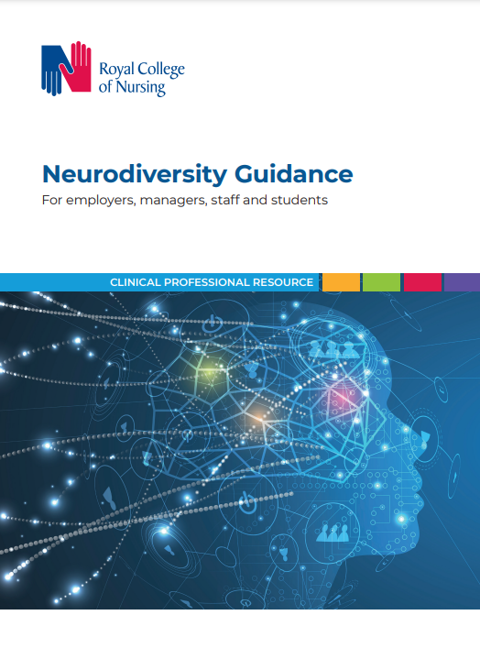
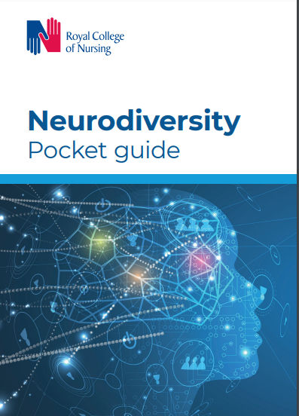
Guidance and pocket book
https://www.rcn.org.uk/Professional-Development/publications/neurodiversity-guidance-uk-pub-010-156

Slide 9
Neurodiversity Guidance Website
https://www.rcn.org.uk/get-help/member-support-services/peer-support-services/neurodiversity-guidance

Slide 10
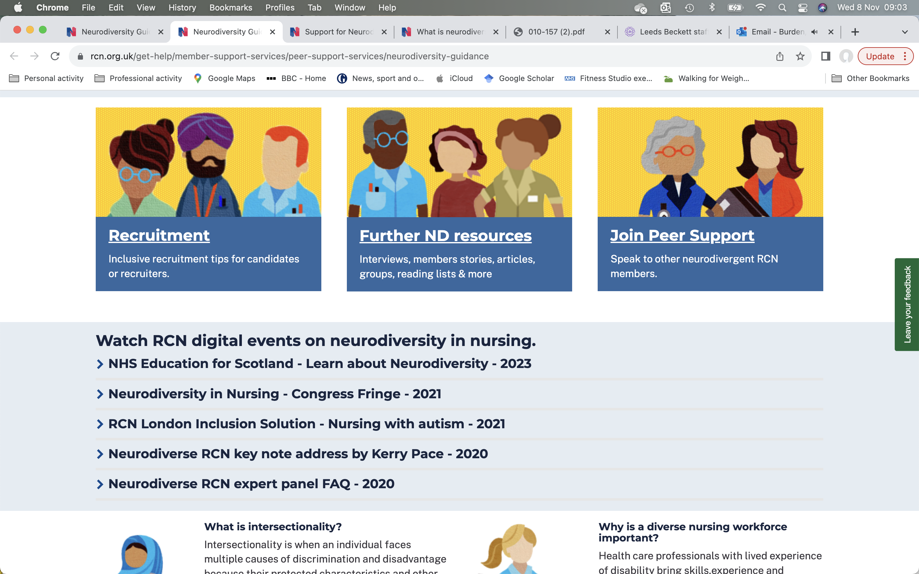

Slide 11
Support for neurodivergent nursing staff – what works?
Will be different for each individual
As many people have more than one neurodivergent condition, effects may overlap and therefore different strategies & adjustments required.
Many divergent conditions part of a spectrum (variability)
The neurodivergent nurse is the best person to know what will work for them along with recommendations from diagnostic reports.
Strengths based approach (what are the individual’s strengths?)
Still need to meet professional requirements.

Slide 12
Being Neuroinclusive: what does this look like?
Awareness
Open supportive environment and team (Practice Assessor / Supervisor are key people)
Send information in advance and in an accessible format
Ask everyone as a routine (disclosure – risk / benefit)
what reasonable adjustments (individualized support)
what works well/not well for them (individual’s own strategies)
Use technology
Offer examples/ templates
Recognize overwhelm (or that the person is still trying to understand their condition and what might work for them)
Be a role model / champion
Consider strengths as well as challenges

Slide 13
Reasonable Adjustments in Practice
Preparation
Meeting early
Review plan for the shift after handover
Quiet areas to write notes/ work
Use of assistive technology
Use of phones/timers
Speech to text
Text to speech
Adjustments to hours
Rest breaks
Might need to take breaks away from others
Work environment
Consider sensory needs
Consider type of work

Slide 14
Wellbeing
Higher level of anxiety and depression in neurodivergent people (Ellis et al 2023)
Masking and the extra work of meeting norms is exhausting
Burnout and meltdowns can occur
Support:
Neurodiversity networks – through social media or work-based
Healthy lifestyle
Exercise
Sleep
Mentor
Psychological support
Notes:
Consider also past experiences
Double empathy and relating to/ communicating with those who are autistic better

Slide 15
Assistive Technology
Focus: Forest, Focusmate
Text to speech: inbuilt in Word, Adobe Acrobat, Natural Reader, Claro, Read & Write Gold, scanning pens, Google
Speech to text: Otter ai, Siri, Dragon, Google, Microsoft
Note taking: Notably, One Note, Evernote, Google Keep
Grammar and spelling: Grammarly, Claro, Read & Write Gold
Mind mapping: Inspirations, XMind, Mindomo, Scapple
Reminders: Alexa, phones, Don't forget the milk, Microsoft to do, Google Keep
Need support/training to use many of these effectively
Access to work grants https://www.gov.uk/access-to-work

Slide 16
Discussion
What are your experiences of supporting students who are neurodiverse?
What have been the strengths and some of the challenges?
How adjustments have been easy to make, and what have presented more challenges?
What has been the impact on learning and assessment?

Slide 17
References and additional reading
Chinn, S. J. (2012) More trouble with Maths: A Teachers complete guide to identifying and diagnosing mathematical difficulties. New York: Routledge
Clouder, L., Karakus, M., Cinotti, A., Ferreyra, M.V., Fierros, G.A. and Rojo, P. (2020) Neurodiversity in higher education: a narrative synthesis. Higher Education 80: 757-778.
Mellifont, D (2021). Ableist ivory towers: a narrative review informing about the lived experiences of neurodivergent staff in contemporary higher education. Disability & Society, ahead-of-print(ahead-of-print), 1–22. https://doi.org/10.1080/09687599.2021.1965547
Ellis, E., Kirby, A. and Osborne, A. (2023) Neurodiversity and Education Thousand Oaks: Corwin
Evans, Granson, M., Langford, D., & Hirsch, S. (2023). Autism spectrum disorder: reconceptualising support for neurodiverse students in higher education. Journal of Higher Education Policy and Management, ahead-of-print(ahead-of-print), 1–15. https://doi.org/10.1080/1360080X.2023.2180168
Hamilton, L.G and Petty, S. (2023) Compassionate pedagogy for neurodiversity in higher education: A conceptual analysis Frontiers in Psychology Volume 14. https://doi.org/10.3389/fpsyg.2023.1093290
Katzman, M. A., Bilkey, T. S., Chokka, P. R., Fallu, A. and Klassen, L. J. (2017) 'Adult ADHD and comorbid disorders: clinical implications of a dimensional approach', BMC Psychiatry, 17(1), pp. 302
Kirby, A. and Cleaton, M. (2019) Neurodiversity 101: Part 8 Co-occurrence: Do-IT Solutions. Available at: https://doitprofiler.com/wp-content/uploads/2019/07/ND101-What-is-co-occurrence-and-why-important.pdf (Accessed: 8th December 2019)

Slide 18
References and additional reading
Kirby, A., Edwards, L., Sugden, D. and Rosenblum, S. (2010) 'The development and standardization of the Adult Developmental Co-ordination Disorders/Dyspraxia Checklist (ADC)', Research in Developmental Disabilities, 31(1), pp. 131-139
Micheva, E. (2018) 'Are neurodevelopmental disorders discrete conditions?', The Psychologist, 31, pp. 24-27.
National Autistic Society (2016) What is autism? Available at: https://www.autism.org.uk/about/what-is/asd.aspx (Accessed: 8th December 2019)
Rose, J. (2009) Understanding and Teaching Children and Young People with Dyslexia and Literacy Difficulties Annesley: DCSF Publications. Available at: http://webarchive.nationalarchives.gov.uk/20130401151715/https://www.education.gov.uk/publications/eOrderingDownload/00659-2009DOM-EN.pdf
Royal College of Nursing (2022) Neurodiversity Guidance for employers, managers, staff and students Available at: https://www.rcn.org.uk/Professional-Development/publications/neurodiversity-guidance-uk-pub-010-156
Royal College of Nursing (no date) Neurodiversity guidance Available at: https://www.rcn.org.uk/get-help/member-support-services/peer-support-services/neurodiversity-guidance
Shah, P.J, Boilson, M., Rutherford, M., Prior, S., Johnston, L., Maciver, D. and Forsyth, K. (2022) Neurodevelopmental disorders and neurodiversity: definition of terms from Scotland’s National Autism Implementation Team The British Journal of Psychiatry 221, 577–579. doi: 10.1192/bjp.2022.43
Taylor, K. E. and Walter, J. (2003) 'Dyslexia and occupation', Dyslexia, 9(3), pp. 177-185.
Walker, N. (2023) Neurodiversity: some basic terms and definitions Available at: https://neuroqueer.com/neurodiversity-terms-and-definitions/

