Slide 1
Practice Assessor conference
Developing your skills in feedback for learning and assessment
8th November 2023

Slide 2
Session aims
What is feedback?
How does feedback support our learners?
Professional experiences of feedback situations – reflective discussion
Positive examples of learner feedback from Practice Assessors
Top tips for providing learner feedback

Slide 3
What is feedback?
Feedback supports learners to think about the gap between real and anticipated performance, find methods to reduce the gap, and consider strategies to improve on it.
Feedback stimulates reflective and experiential learning and encourages learners to reflect on feelings, experiences and incidents.
Learners use feedback to make sense of their clinical practice, alongside the application of theory into practice, and reflection on their experience.
It is a valuable tool that motivates better performance.
However:
Learner perceptions of feedback vary.
Barriers to the provision of constructive feedback include busy schedules; lack of communication skills.
Feedback given in clinical settings can be too generic and ill-timed.

Slide 4
How does feedback support our learners?
NMC (2018) SSSA requirement
Can take different forms but should always be timely, collaborative and constructive
Supports achievement of proficiencies, professional values and skills
Highlights areas where support and further learning may be required
Improves overall practice and professional conduct
May involve working with PS and AA to develop an action plan.
Notes:
Need to stress the importance of documentation - adding relevant observations on the student’s conduct, proficiency and achievement to the epad.
Post-reg: stress importance on student’s role in developing their learning through the portfolio – student-led. PA feedback should be constructive and based on reflective discussion.

Slide 5
Professional experiences of feedback situations – reflective discussion
What sort of learner feedback have you been involved with?
How does it feel to give learner feedback?
Why might it be uncomfortable to ask for/receive learner feedback?
How has learner feedback helped you to develop your own practice?
Memorable learner feedback incidents – why?
Notes:
Reflective discussion on own experience of giving learner feedback as PA/PS
Prompts could include styles of giving feedback, what works and what doesn't, purpose of asking learners for feedback etc.
Role-modelling
Student interviews have areas for student comments – include reflection from tripartite reviews and 360 feedback

Slide 6
How to document?
It is often useful to use a framework or headings to help you structure your feedback – examples are:
The 6 C's - Care, Compassion, Competence, Communication, Courage and Commitment
The NMC Code – Prioritise People, Practise Effectively, Preserve Safety and Promote Professionalism and Trust
Your Trust Values
Post-Registration: Use a learners' Learning Contract to structure your feedback

Slide 7
Positive examples of learner feedback received from Practice Assessors

Slide 8
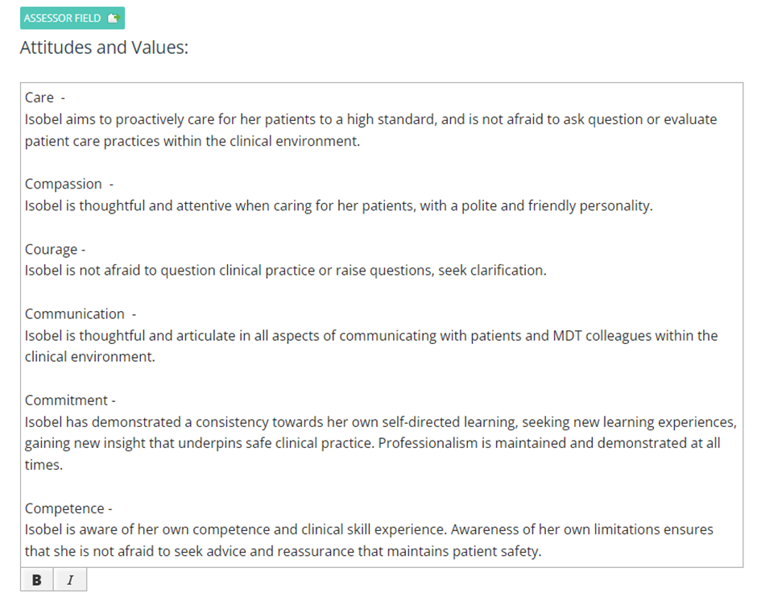
Example of good feedback
Practice Assessor feedback for a Pre-Registration Adult Nursing student
Notes:
Has used the 6 C's to structure the framework

Slide 9
Example of good feedback
PRACTICE ASSESSOR FEEDBACK FOR A post-REGISTRATION SCPHN NURSING STUDENT
Notes:
Eg. SPHN learning contract – self-directed exercise, with PA support to consider breadth of learning. PA shared own role in the learning process (expert / co-learning). Reflects Trust values.

Slide 10
Example of good feedback
PRACTICE ASSESSOR FEEDBACK FOR A post-REGISTRATION SCPHN NURSING STUDENT
Notes:
Eg. Another LC, this time with further encouragement to question and expand the evidence base used in practice. Great role-modelling and openness to lifelong learning. Uses student LC to structure feedback, ongoing iterative process where learning is constructive.

Slide 11
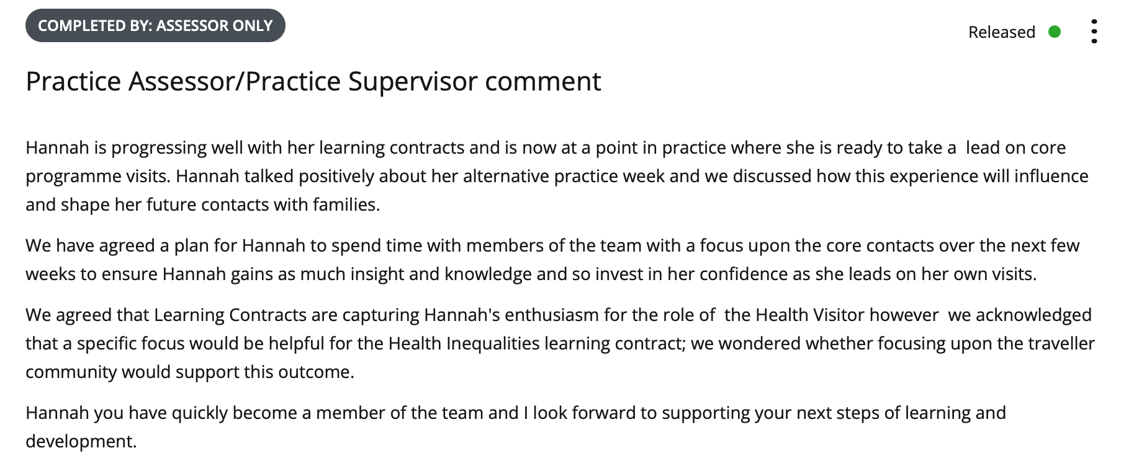
Example of good feedback
PRACTICE ASSESSOR FEEDBACK FOR A post-REGISTRATION SCPHN NURSING STUDENT
Notes:
Eg. Mid-point review:
Practice reflection on student independence on visits. Agreed plan to build / scaffold knowledge and skills through wider team working – creating learning opportunities (PA is not just the source of knowledge acquisition). Collaborative learning and assessment is really clear.

Slide 12
Top tips for providing learner feedback (Peters et al (2023))
Plan in advance and give feedback in a timely manner
Concentrate on the behaviour, not the person
Each learner is different so tailor your feedback to the individual
Be specific, be realistic, own the feedback. Use ‘I’ rather than ‘they’ or ‘one’: “When you said…, I thought that you were…”
Ensure feedback given is balanced, incorporating positive as well as constructive points
Be aware of non-verbal cues such as facial expression, eye contact, body language, and verbal cues including tone and volume
Be mindful of your own emotional state as the more relaxed you are, the more relaxed the other person is likely to feel
Limit or remove all external distractions (for example having a private space, turning off IT devices, clearing your diary)
Allow time for the receiver to process the information and ask questions
Document – summarise the session in a letter/email and follow up on what has to be discussed
Self-reflect after the session. Acknowledge what went well and what could be further improved in the future
Peters A et al (2023) Giving and receiving feedback: a training resource for student nurses. Nursing Times [online]; 119: 3.

Slide 13
Questions?

