Slide 1
Practice Assessor and Practice Supervisor Educator Conference 2023/2024
Engaging with apprentices to apply KSBs in clinical practice
Wednesday 8th November 2023
Breakout Room 2, facilitated by:
Jenny Doak, Lecturer in Nursing and
Laura Brown, Degree Apprenticeship Assessor

Slide 2
Agenda
What are KSBs?
Action planning
Identifying and creating opportunities for apprentices
Discussion

Slide 3
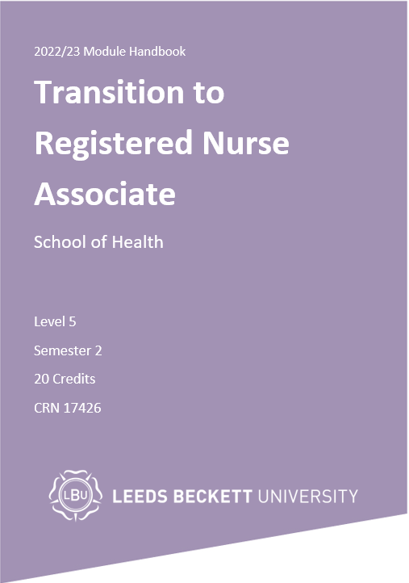
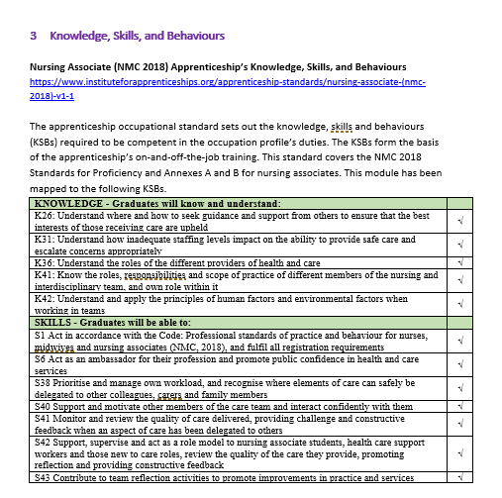
What are KSBs?
Every apprenticeship is made up of a set of Knowledge, Skills and Behaviours (KSBs) which defines competence within that occupation.
Apprenticeships are managed by the Institute for Apprenticeships and Technical Education (IfATE) who engage with sector employers and professional bodies to develop the apprenticeship standards to ensure they are relevant and up to date and align with professional requirements.
The content and format of the Degree Apprenticeship is designed to meet the required KSBs, so on successful completion of the apprenticeship the apprentice will be able to consistently demonstrate competence.
You can find the full details of the KSBs mapped to all modules in the Degree Apprenticeship Module Handbooks and on the IfATE website
Nursing Associate
Registered Nurse
An extract of some of the knowledge and skills mapped to this module:
Notes:
Summary:
- KSB’s specific to your apprenticeship
Align with NMC standards of proficiency
Emphasise the importance of including the KSB’s on activity log.

Slide 4
Advice to Apprentices
Log your off the job learning time in your activity logs every week
Consider and reference the KSBs that are relevant to the module when planning and reviewing your assignments
Link the off the job learning (including university time, placement and self directed study) to the KSBs
Reflect on how the KSBs link to your time at work (on the job learning) – how is that experience helping you progress against the KSBs?
Discuss this with your practice assessor and line manager
Do this every day or weekly or you won’t remember!
Prepare for your Tripartite Review meetings – using this time to consider how you are progressing against the KSBs and where you might need more support

Slide 5
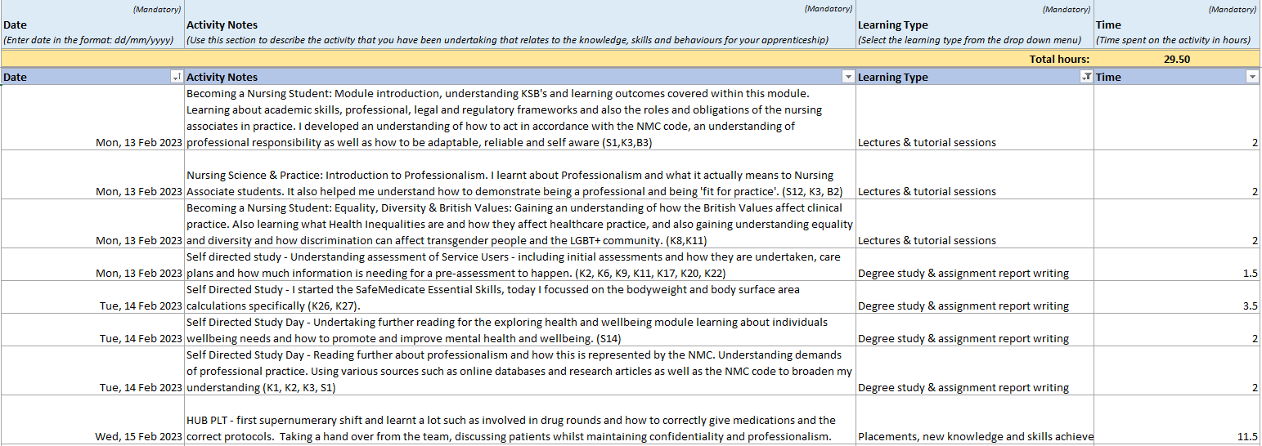
Example Activity Log:

Slide 6
Identifying and creating opportunities for apprentices
Hub/Primary Placement
Opportunities with the wider MDT
Observing surgeries in theatre
Specialist areas and roles i.e. TVN nurses, discharge team
GP Practice: health visitor / community, clinics
Leadership and delegation within role
Observation of process when concerns are raised
Understanding and awareness of the patient journey

Slide 7
Action Planning
Initial Discussion
Monitoring and Review
Progression and Future Planning
Understand what the apprentice would like to focus their learning on - can these experiences be achieved and how will their expectations be managed?
Review the apprentices current progress and achievements – are the identified opportunities appropriate for where they are in the course?
Reflect on what opportunities stood out when you were training and how can you impact on their learning and development?
How do you feel the experience has helped develop the apprentice, for example has their recent placement helped develop key skills?
Check in with the apprentice to see how they feel they are progressing and encourage them to identify tasks that they would like to focus on (if possible) at the start of a shift.
What targets do you as a practice assessor / supervisor feel are important areas to focus on and learn
What examples can they provide during their tripartite meetings to evidence the KSBs
Apprentices should be taking ownership of their learning and development, highlighting areas of interest however, some may need additional support if they are new to the area.

Slide 8
Discussion: What opportunities are available for apprentices in your place of work?

