Slide 1
Introduction to the undergraduate marking descriptors
2023

Slide 2
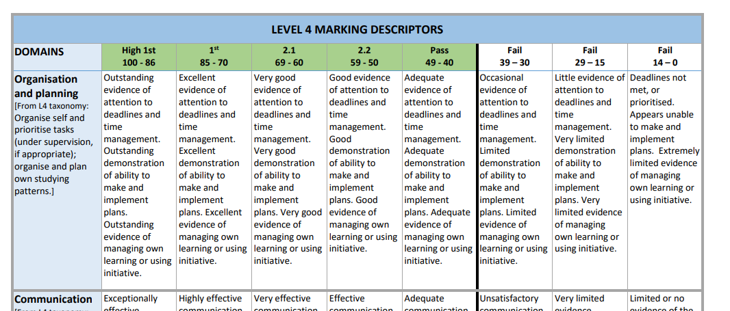
Overview
These descriptors are not designed to be prescriptive, but rather to be used as an adaptable flexible framework for you as you develop and write their own assessment modes and marking criteria.
These general descriptors over level 4, 5 & 6) can be used to support a range of assessment modes (written, video, podcast, poster, or performances).
These general descriptors are not intended to be student facing, or to be used in module handbooks.
Notes:
Next steps - (Add to Chat)

Slide 3
How to use the descriptors
The wording of the general descriptors can be selectively modified and/or repurposed to suit your own assessment criteria, subject / disciplinary values, and assessment marking weightings.
The descriptors should also be considered by staff as they design course- specific marking descriptors, review assessment processes and modify assessment design.
Notes:
Next steps - (Add to Chat)

Slide 4
Example of their adaptation
I have a level 4 module in which I plan to use a presentation
I develop marking criteria which includes assessment against the learning outcomes; use of resources and presentation skills drawing upon the undergraduate descriptors.
I adapt wording from the following areas of the L4 grid: communication; technical capabilities; information/data collection & group/interpersonal
A group oral presentation, with contributions from each individual | Weighted at 40%
Learning Outcomes Assessed: | LO1 & LO2
Notes:
Next steps - (Add to Chat)

Slide 5
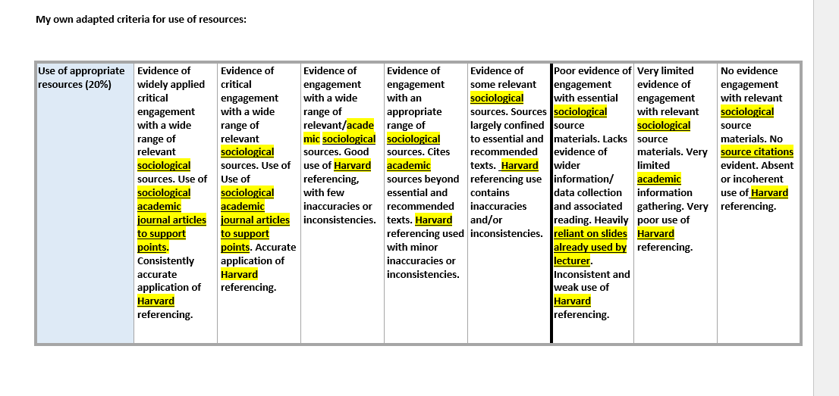
Example of their adaptation
Notes:
Next steps - (Add to Chat)

Slide 6
Any questions
Any queries - email clt@leedsbeckett.ac.uk

